Slide 1
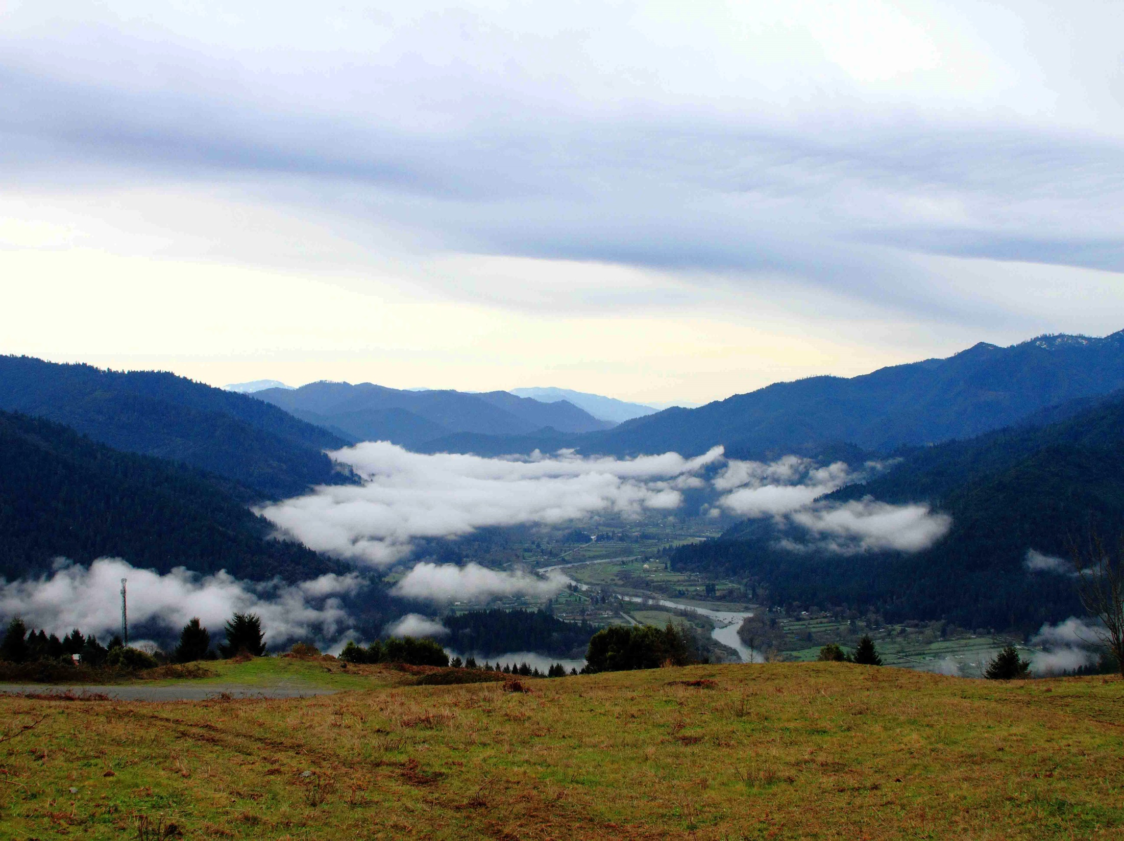
Marijuana Cultivation and Environmental Concerns
Hoopa Valley Tribal EPA
Ken Norton, Director

Slide 2
Repeal Title 34 The Marijuana Cultivation Suppression Initiative
We the undersigned members of the Hoopa Valley Tribe, and citizens of the Hoopa Nation, herby petition the Election Board to conduct a Referendum election to Repeal Title 34, The Marijuana Cultivation Suppression Ordinance in its entirety.
Title 34, The Marijuana Cultivation Suppression Ordinance, provides for the legal authorization to search and seize property, impose fines, and exclude tribal members from the reservation, for cultivation of marijuana. Federal law does not require tribes to adopt of enforce such an ordinance. Repealing Title 34 will have no legal effect on future federal funding, nor will it affect the tribes sovereign right to self governance. The Department of Justice has declared that, under certain circumstances, Indian Tribes my be able to grow marijuana in states that have legalized it for medicinal and/or recreational use, while potentially avoiding prosecution. California has legalized marijuana cultivation and use for medicinal purposes. Tribal members should not be subject to the threat of discriminatory prosecution and additional penalties by its government for the cultivation of marijuana/cannabis on deeded or tribally assigned or leased land. Repeal of Title 34 will provide Tribal members with the right to make their own choices about medicinal use of marijuana, and the right tot participate in a stat/county regulated, agricultural industry. Tribal timberlands will remain protected from trespass through enforcement of the Conservation/Trespass Ordinance, Title 15.

Slide 3
Proposed initiative restricts cultivation of marijuana to the urban zone
Marijuana cultivation is prohibited outside the urban area

Slide 4
Potential agriculture land for cultivation activities
Includes Fee, Individual Trust & Tribal Trust properties

Slide 5
Tribal Ordinances
Title 37- NO APPLICATION OF PESTICIDES and HERBICIDES
Title 10- Does NOT have agriculture regulatory terms and conditions; NO agricultural bonds required
Adopting proper Permitting and Licensing processes
Adopting proper Mitigation measures
Buffer zones; water recycling; catch basins

Slide 6
Current Agriculture Example
Regulations and policies should apply to all agriculture activities

Slide 7
Development of Agriculture Department
Responsible for regulatory activities
Licensing/ permitting/ fee collection
Monitoring
Planning and support
Personnel and Compliance

Slide 8
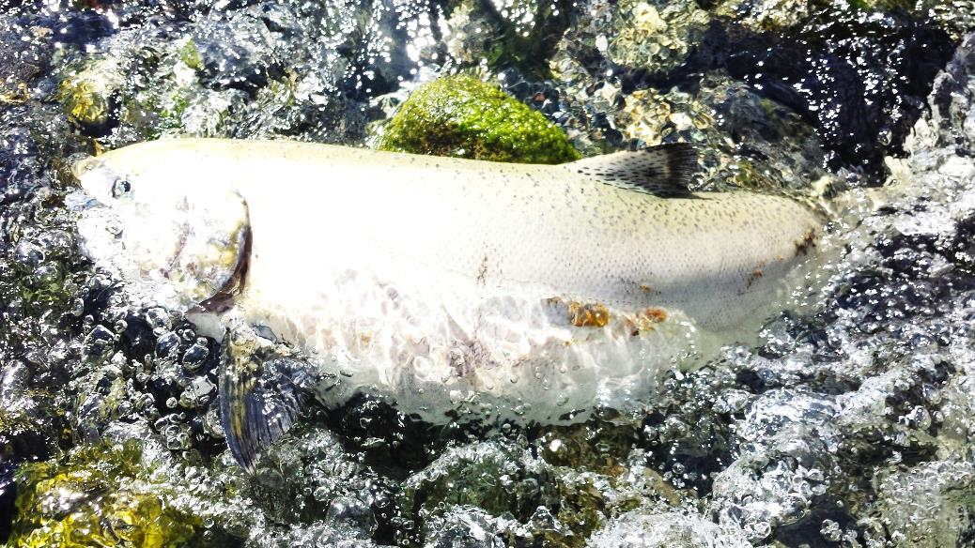
Zero Net Discharge
Zero net discharge of nutrients (fertilizers), pesticides, herbicides into tribal waterways
Trinity River Algae Growth 2014

Slide 9
Immediate Environmental Concerns
Water Quality
Nutrient Loading (fertilizers; nitrogen; phosphorus)
Excess nutrients linked to contributing growth of cyanotoxin producing algae
Water Quantity
Carrying capacity of irrigation streams do not meet current agricultural demands
Dewatering of tributaries effects on salmonids
ESA requires a maximum 20% of instream flow allocated for irrigation

Slide 10
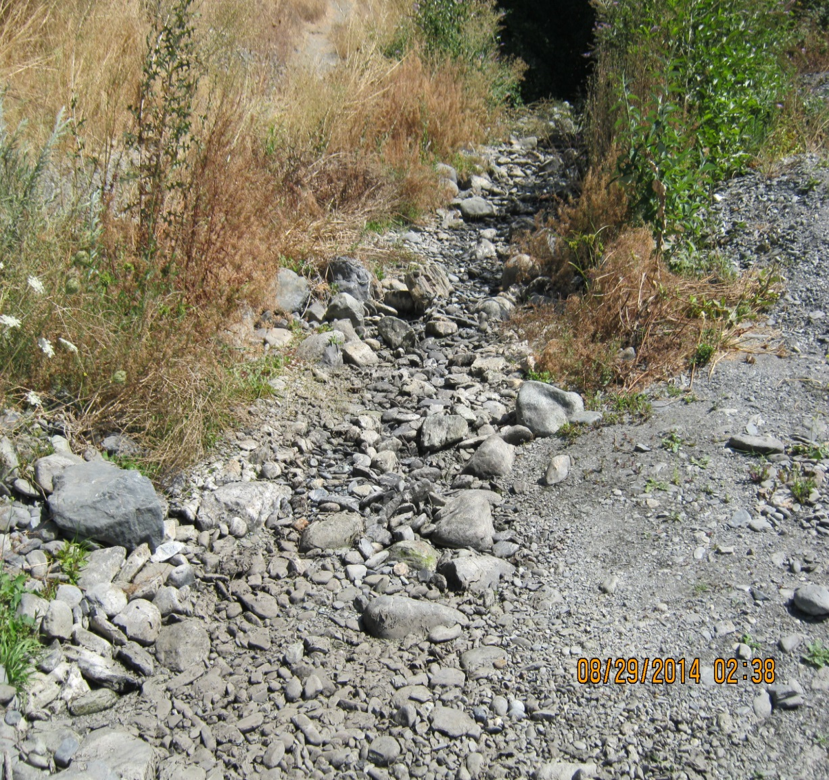
Negative Effects Hostler Creek Summer 2014
Hostler Creek and Trinity River Confluence
Hostler Creek Below HWY 96 Crossing

Slide 11
Environmental Protection Goals If Marijuana Initiative is Passed
Ordinances, Regulations, and Policies
Location of cultivation activities
Department development for proper oversight
Compliance of zero net discharge
Protection of water quality & quantity

